Slide 1


DATA BREACH or DATA SCRAPE ?
the LinkedIn 2021 Data Leak
CTEC-114 Fall 2022
Jeffrey S. Walley

Slide 2
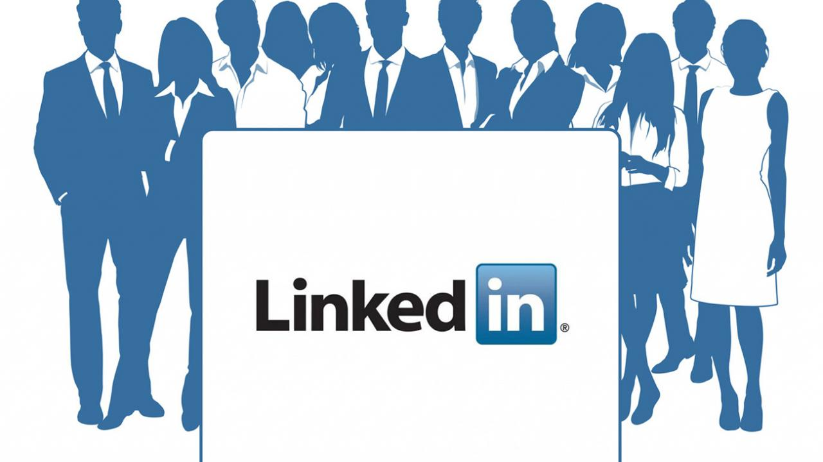
What company was involved?
Linkedin was the company involved in the data breach.

Slide 3

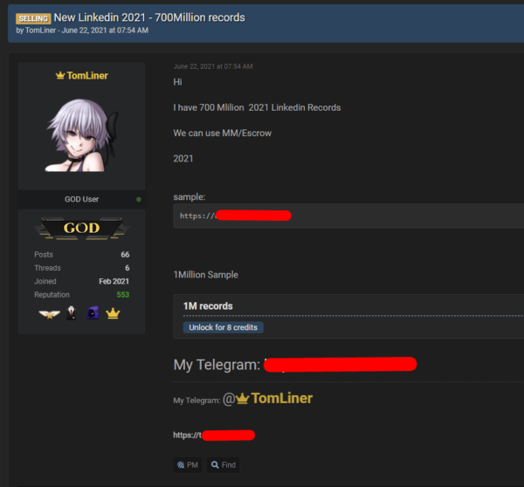
Who perpetrated the breach?
A user known as ‘TomLiner’, using the moniker ‘GOD user’ perpetrated the information gathering.

Slide 4

What exactly happened?
LinkedIn’s API (Application Programming Interface) was misused to gain access to personal data.
Information such as full names, gender, email addresses, phone numbers, and industry information were gathered into a database.

Slide 5

When did the breach occur?
A posting offering user data for sale appeared on June 22nd, 2021.
This Photo by Unknown Author is licensed under CC BY-NC

Slide 6

Where did the data turn up?
Information was dumped to a Dark Web forum site, “RaidForums”.
1 million users’ personal data was included as a sample.
This Photo by Unknown Author is licensed under CC BY-SA

Slide 7
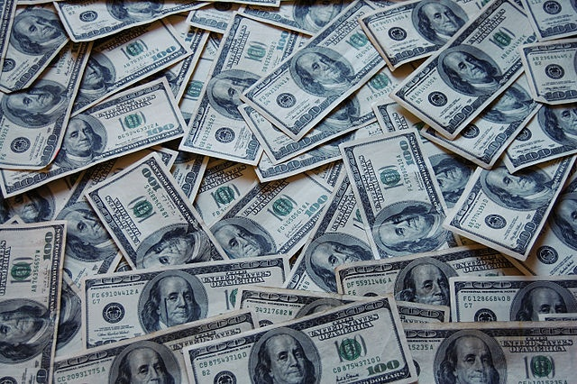
Why did the breach occur?
TomLiner claimed to have millions of users’ personal information available for purchase.
This Photo by Unknown Author is licensed under CC BY

Slide 8

How many users were affected?
Over 700 million users had personal data ‘scraped’ and put into a database.
This Photo by Unknown Author is licensed under CC BY-NC-ND

Slide 9
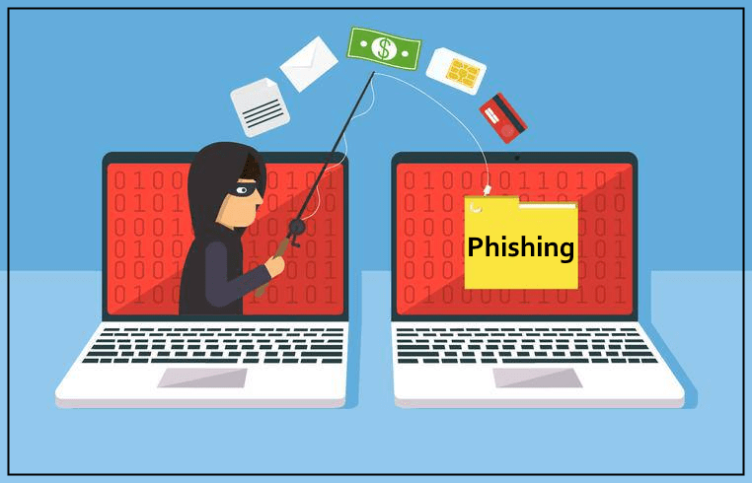
What damage was caused by the breach?
The reputation and policies of Linkedin were scrutinized due to the incident.
Business and personal Linkedin users were affected.
With the information obtained by scraping, there were possibilities of increased phishing attacks.
This Photo by Unknown Author is licensed under CC BY-NC-ND

Slide 10

How did Linkedin respond?
Released a statement saying the company considered the incident a violation of the “Terms of Service”, not a data breach.
Put in place filters to help block scraping tools.
This Photo by Unknown Author is licensed under CC BY-NC-ND

Slide 11

What could the company have done differently?
Let users know to better protect their own information.
Find a way to secure user data.
They could have defended against scraping before the incident.
This Photo by Unknown Author is licensed under CC BY

Slide 12


Additional information that I learned during research:
There are tools that help instruct users
Jigsaw’s ‘Phishingquiz.withgoogle’
‘KnowBe4’ is a site with free and pay training
There are various sites where you can freely download ‘scraping’ applications to gather information
In April 2022, the US courts ruled that a company named ‘HiQ’ could legally scrape and sell user data to other businesses.
This Photo by Unknown Author is licensed under CC BY

Slide 13
References
https://www.csoonline.com/article/2130877/the-biggest-data-breaches-of-the-21st-century.html
https://news.linkedin.com/2021/june/an-update-from-linkedin
https://blog.linkedin.com/2021/july/15/linkedin-safety-series-what-is-scraping
https://cybernews.com/news/stolen-data-of-500-million-linkedin-users-being-sold-online-2-million-leaked-as-proof-2/
https://scrubbed.net/blog/linkedin-data-leak-what-we-can-do-about-it/
https://www.forbes.com/sites/zacharysmith/2022/04/18/scraping-data-from-linkedin-profiles-is-legal-appeals-court-rules/?sh=77339fbd2a9c
https://phishingquiz.withgoogle.com/
https://www.knowbe4.com/

